Slide 1
CI/CD para Bases de Datos
Docker, Kubernetes y Gitlab CI

Slide 2
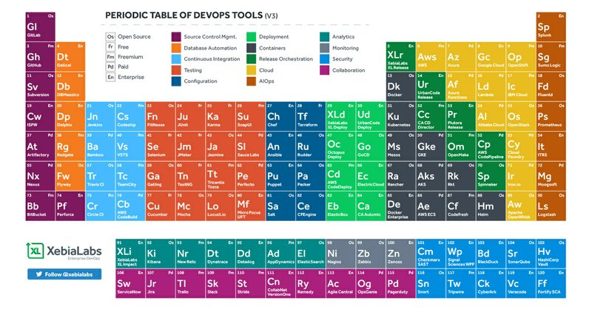
Contenido
Devops
CI/CD
Docker
Flyway
Kubernetes
SQL
YAML!!

Slide 3
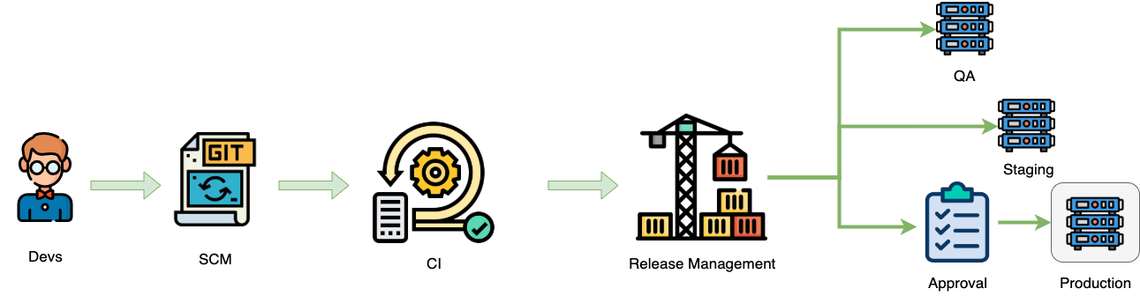
CI/CD Casual para Aplicaciones

Slide 4
CI/CD Casual para Aplicaciones

Slide 5
CI/CD Casual para Aplicaciones

Slide 6

CI/CD Casual para Aplicaciones

Slide 7




CI/CD Casual para Aplicaciones

Slide 8


¿Qué pasa con nuestras Bases de Datos?

Slide 9

¿Qué pasa con nuestras Bases de Datos?

Slide 10




¿Qué pasa con nuestras Bases de Datos?

Slide 11

¿Donde nos gustaría estar?

Slide 12

CI/CD

Slide 13
¿ Cuánto tiempo les tomaría en colocar/cambiar un typo en ___________ (producción) ?

Slide 14
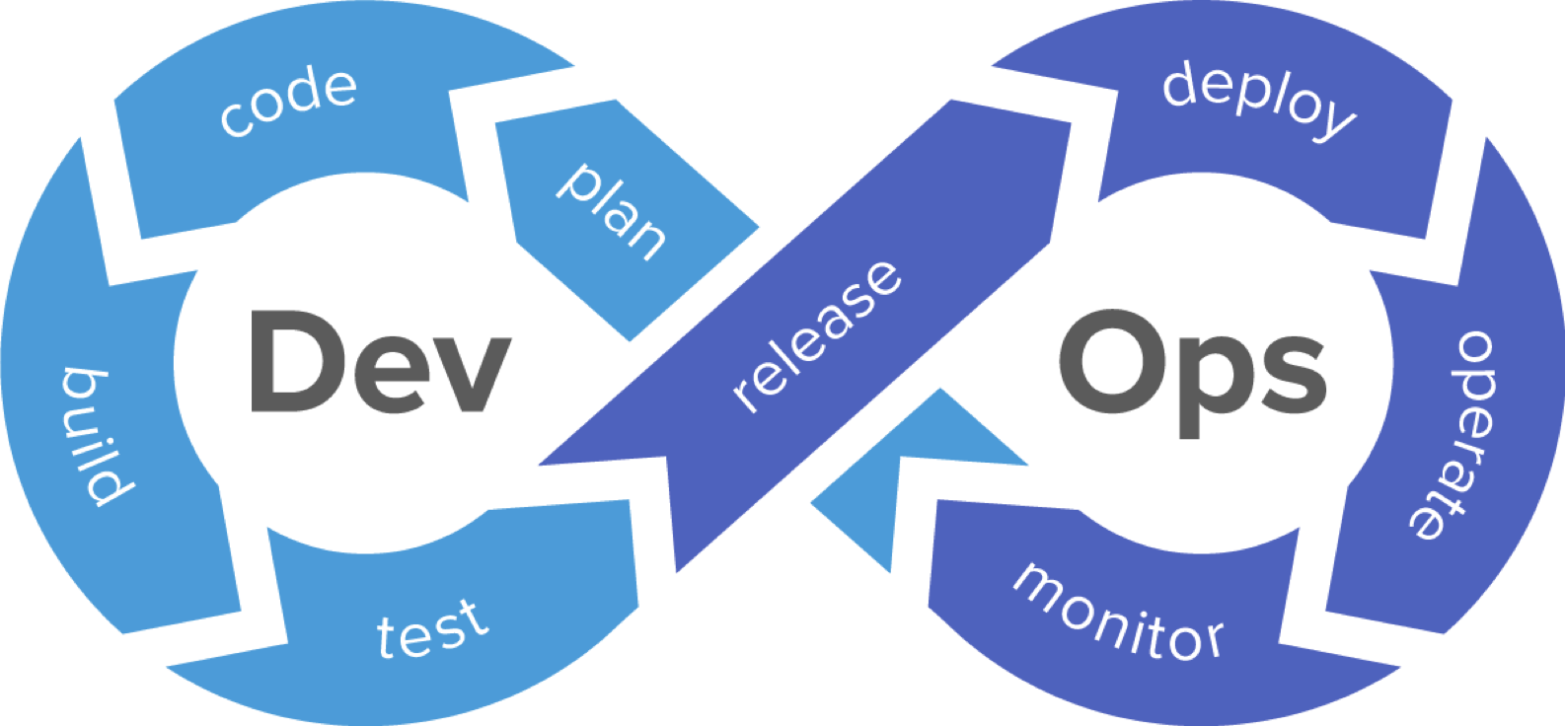
Devops

Slide 15
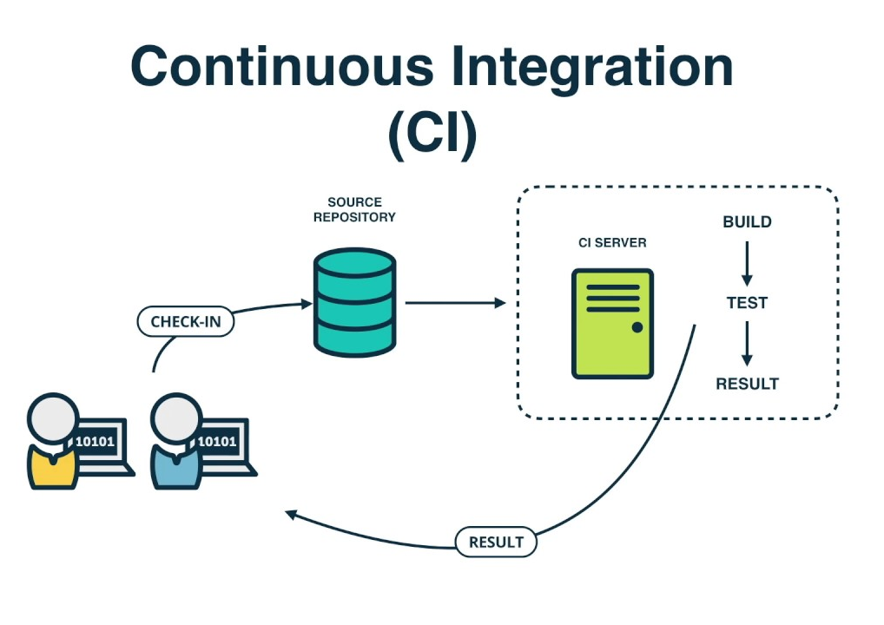
Continuous Integration
(CI)

Slide 16
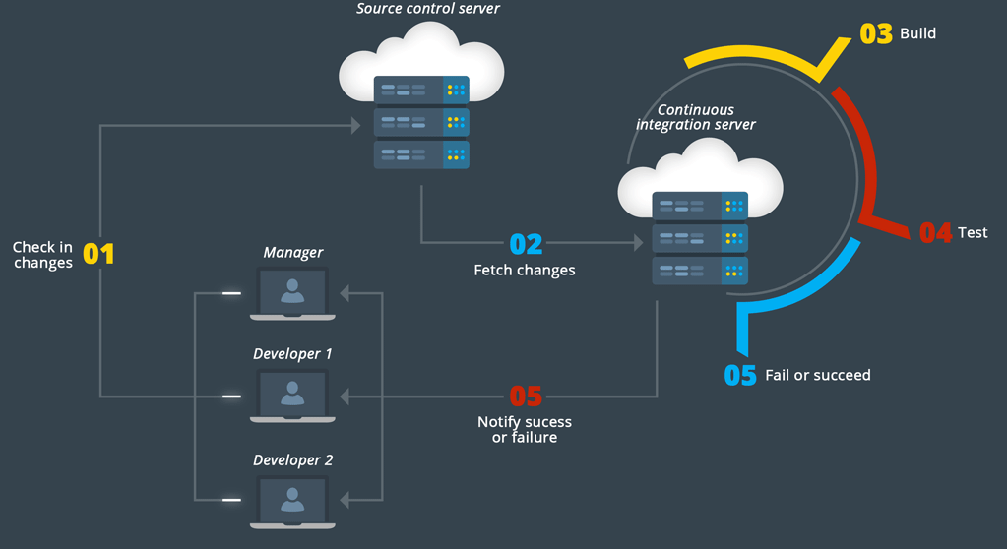
Continuous Integration

Slide 17
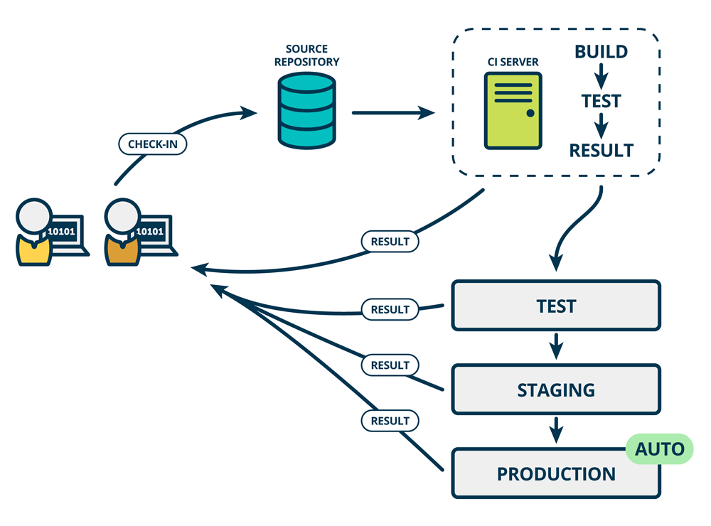
Continuous Delivery vs Deployment
MANUAL

Slide 18
CI/CD best practices
Haz tu CI/CD pipeline la única manera de hacer Releases a producción
Que todos tus ambientes sean muy parecidos (environment parity)
Compila una sola vez (build once and promote everywhere) y promueve tu artefacto a través del pipeline
Que tus pruebas más rápidas corran de primero, para tener un ciclo de feedback más pronto
De ser posible corre tus pruebas en ambientes temporales
Nunca te vayas a casa cuando un pipeline está roto.

Slide 19
Estado Actual segun RedGate’s State of DB Devops
Use of Version Control
Test Automation
81%
52%
40%
15%
App devs
DB devs
App devs
DB devs
Notes:
So the challenges for the database community in 2018 are simple: how to accelerate our personal DevOps transformation by learning new skills, techniques and behaviors; how to accelerate our DevOps transformation by relentlessly trying to break down silos and collaborating across Dev and Ops; and how to contribute back to the wider community by contributing our lessons learnt via blogs, meetups and conferences

Slide 20

Conozcamos nuestro Pipeline

Slide 21


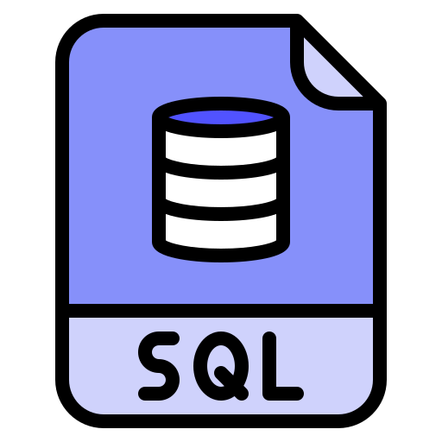


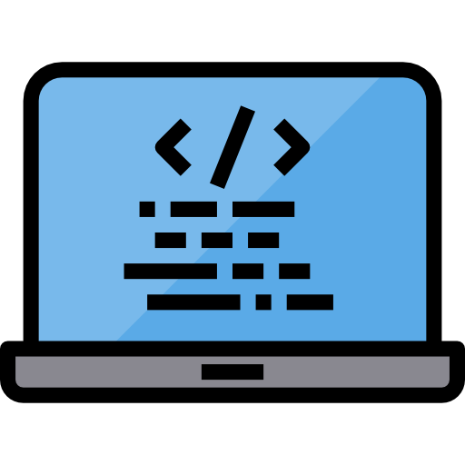

DB devs
SCM
CI
CD
Staging
Production
Nuestro pipeline

Slide 22
DB devs
SCM
CI
CD
Staging
Production
Nuestro pipeline

Slide 23
DB devs
SCM
CI
CD
Checkin
Staging
Production
?
Nuestro pipeline

Slide 24
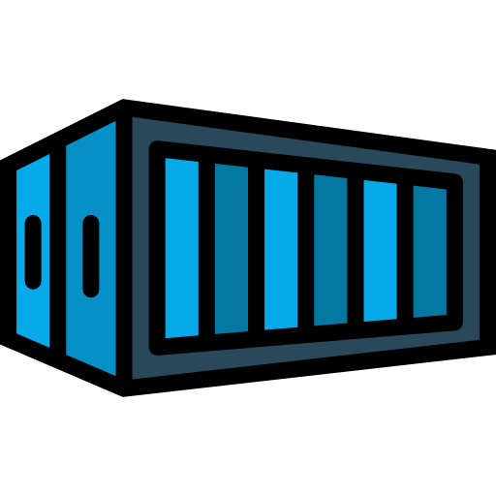

DB devs
SCM
CI
CD
Staging
Docker image with tag.
FlyWay inside image
Migrations are inside image
Production
v1.0.45
Nuestro pipeline

Slide 25


v1.0.45
DB devs
SCM
CI
CD
Staging
Production
Nuestro pipeline

Slide 26
DB devs
SCM
CI
CD
Staging
Production
v1.0.45
Nuestro pipeline

Slide 27
v1.0.45
DB devs
SCM
CI
CD
Staging
v1.0.45
Production
Nuestro pipeline

Slide 28
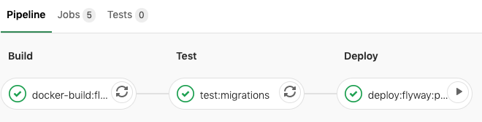
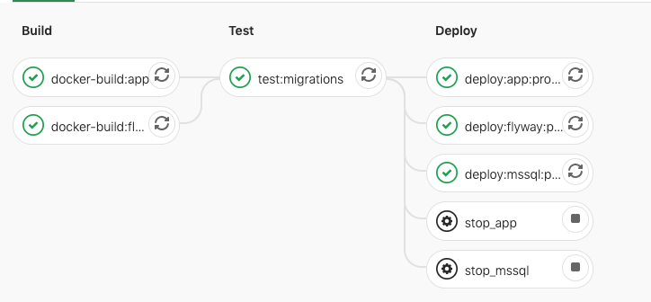
Nuestro pipeline - en vida real

Slide 29

Enter Docker

Slide 30
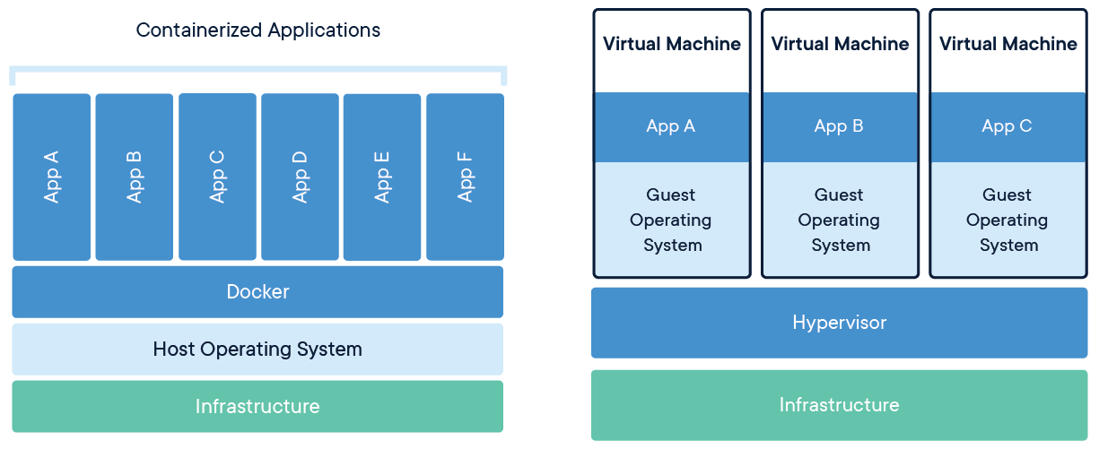
Docker
Notes:
Package Software into Standardized Units for Development, Shipment and Deployment

Slide 31
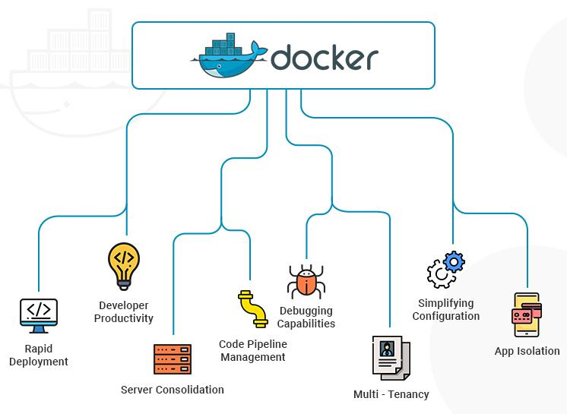
Docker
Env vars injection
Env parity
Containers are ephemeral & idempotent

Slide 32
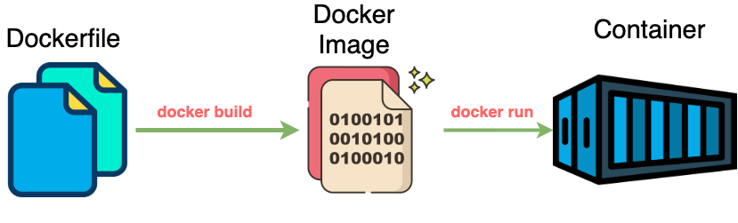
Local Docker workflow
Notes:
A Docker container image is a lightweight, standalone, executable package of software that includes everything needed to run an application: code, runtime, system tools, system libraries and settings
Container images become containers at runtime and in the case of Docker containers - images become containers when they run on Docker Engine

Slide 33
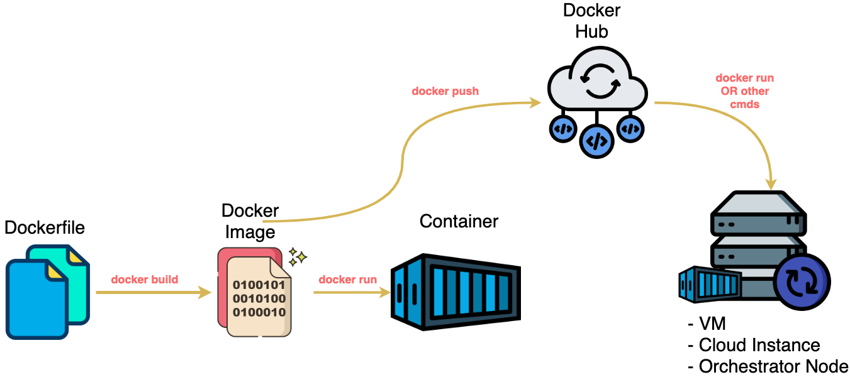
Full Docker workflow
SHARE

Slide 34
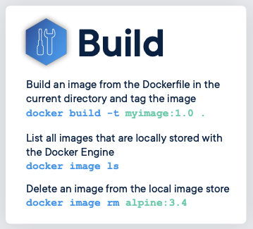
Docker cheat sheet

Slide 35
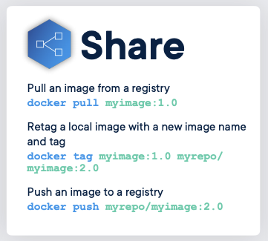
Docker cheat sheet

Slide 36
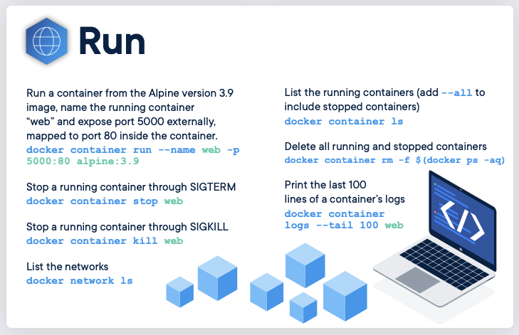
Docker cheat sheet

Slide 37

Database Migrations

Slide 38

Ideas Para hacer migraciones
Aproximacion manual
FlyWay
TypeORM
Muchos Otros.
Notes:
Liquibase (free)
Datical (a paid version of Liquibase)
Redgate (Microsoft Stack)
Delphix (not just for database changes)
DBmaestro (they actually sell as DevOps for databases)
And besides tools for database engines, there are frameworks that support migrations too:
Entity Framework
GORM
Compose
Hibernate

Slide 39

Version control for your database.
Robust schema evolution across all your environments.
With ease, pleasure and plain SQL.

Slide 40
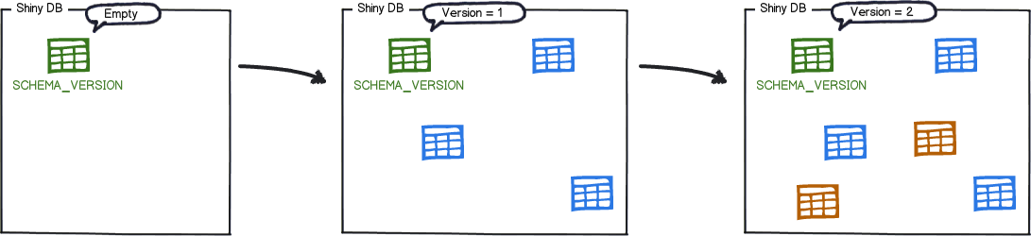
installed_rank | version | description | type | script | checksum | installed_by | installed_on | execution_time | success
1 | 1 | Initial Setup | SQL | V1__Initial_Setup.sql | 1996767037 | axel | 2016-02-04 22:23:00.0 | 546 | true
2 | 2 | First Changes | SQL | V2__First_Changes.sql | 1279644856 | axel | 2016-02-06 09:18:00.0 | 127 | true

Slide 41
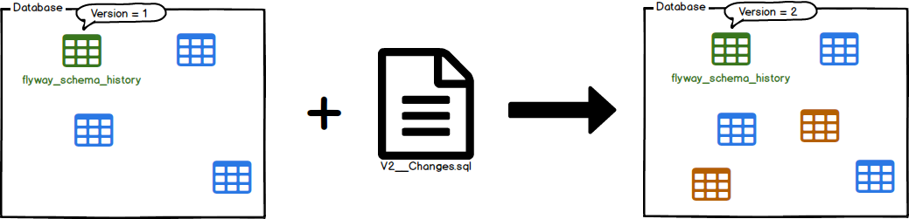
Migraciones con FlyWay
IDEMPOTENT

Slide 42
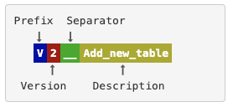
Naming en FlyWay
Versioned Migrations

Slide 43
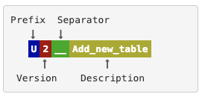
Naming en FlyWay
Undo Migrations

Slide 44
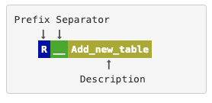
Naming en FlyWay
Repeatable Migrations

Slide 45

Demo*
Con el Maestro ...

Slide 46


Me dijiste que eras Maestro!
Pokemon

Slide 47
*Algunas cosas a notar
SQL Linux Containers deployed a GKE
Integración Gitlab + GKE ya hecha
Utilizare “kustomize” para templating the K8 manifests
GCP VPC Firewall rules aplicadas a mi conveniencia ;)
SQL Server (mssql) VSCode Extension

Slide 48

Gitlab
SCM
Build Server
Agile Board (issue board)
Code review
CI/CD

Slide 49

Links QR Code

